Slide 1
Fragmentation in Coulomb Explosion of Hydrocarbons
Honors Thesis
Advisor: Prof. Kalman Varga
Thesis Committee
Prof. Jean-François Paquet
Prof. Raghav Kunnawalkam Elayavalli
Prof. Julia Velkovska
Samuel S. Taylor
December 2, 2024

Slide 2
Table of Contents
2
1. INTRODUCTION
1.1 Coulomb Explosion ..……………………. 4
1.2 Hydrocarbons …………………………….. 7
1.3 Theoretical Models ………………………. 8
1.4 Research Objectives and Approach ….. 9
2. COMPUTATIONAL METHOD
2.1 Overview …………………………………… 11
2.2 Real Space Grid …………………………... 12
2.3 Hamiltonian ………………………………... 18
2.4 Time Propagator ………………………….. 19
2.5 Complex Absorbing Potential ................. 20
2.6 Ionic Motion ………………………………... 21
2.7 Parameters …………………………………. 22
3. RESULTS
3.1 Laser Parameters and Intensity Optimization … 25
3.2 Methane (CH₄)
3.2.1 Dynamics ………………………………………… 26
3.2.2 Distribution ………………………………………. 27
3.3 Ethane (C₂H₆)
3.3.1 Dynamics ………………………………………… 28
3.3.2 Distribution ………………………………………. 30
3.4 Propane (C₃H₈)
3.4.1 Dynamics ………………………………………... 31
3.4.2 Distribution ………………………………………. 32
3.5 Butane (C₄H₁₀)
3.5.1 Dynamics ………………………………………... 33
3.5.2 Distribution ………………………………………. 34
4. SUMMARY

Slide 3
1. Introduction
3

Slide 4
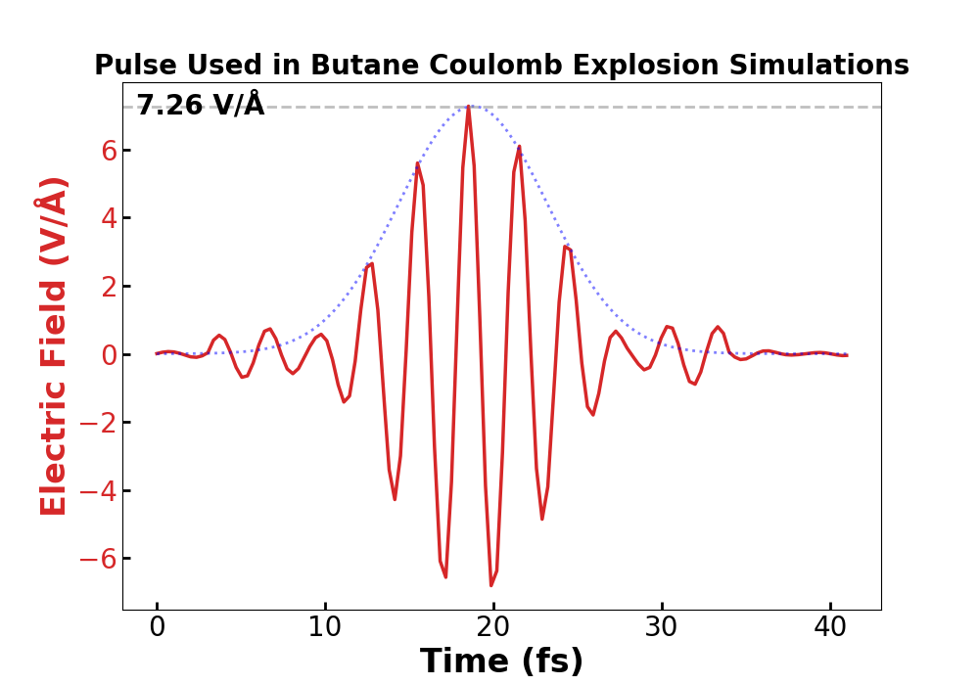

1.1 Coulomb Explosion
4
A phenomenon in which a laser ionizes a molecule, causing the remaining positively charged ions to repel each other.

Slide 5
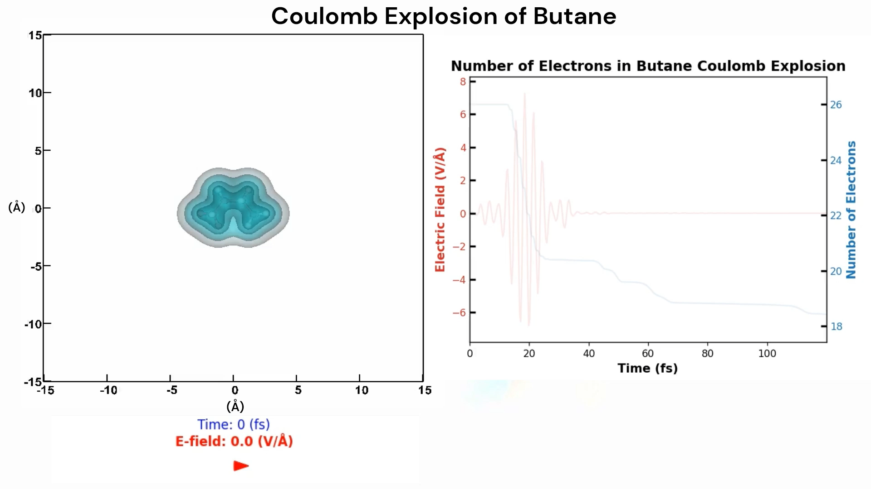

Slide 6
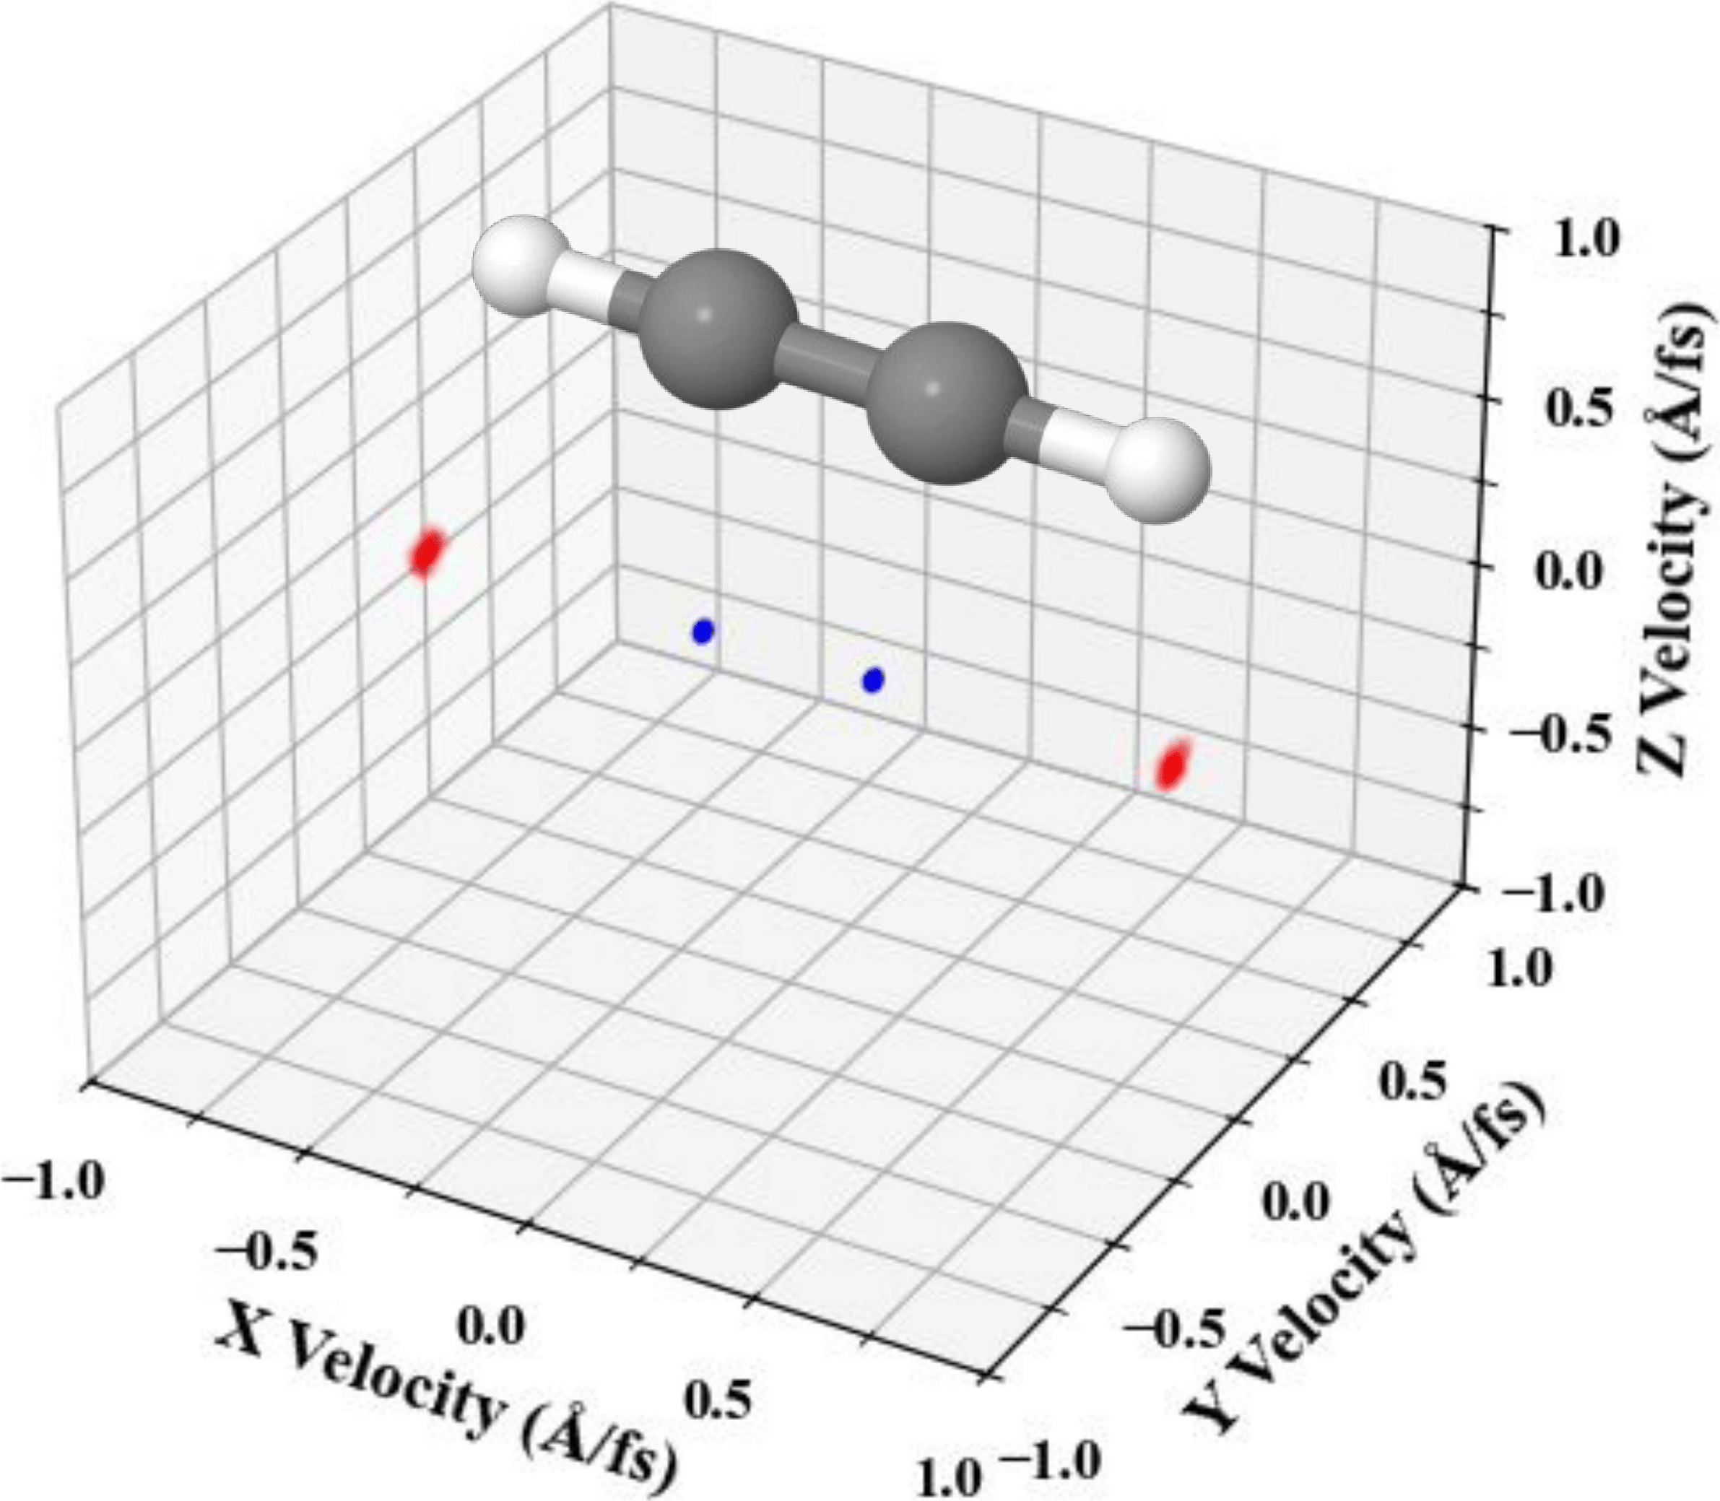
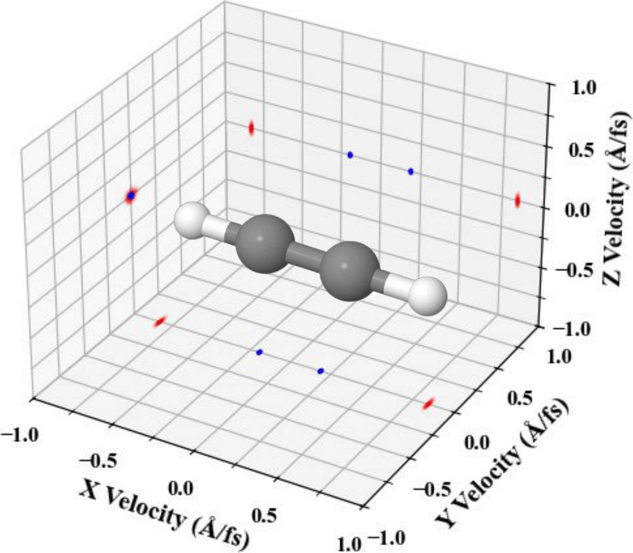
1.1 Coulomb Explosion
6
Recent advancements in ultrafast high-intensity laser technology [1-3] and its diverse applications has made Coulomb explosion (CE) a focal point of recent research.
Applications in:
Molecular imaging [4–29]
Structural dynamics [30–41]
Generation of bright keV x-ray photons [42, 43]
Production of high-energy electrons [44]
Nuclear energy [45–52]
Fragmentation [39, 53-64]

Slide 7
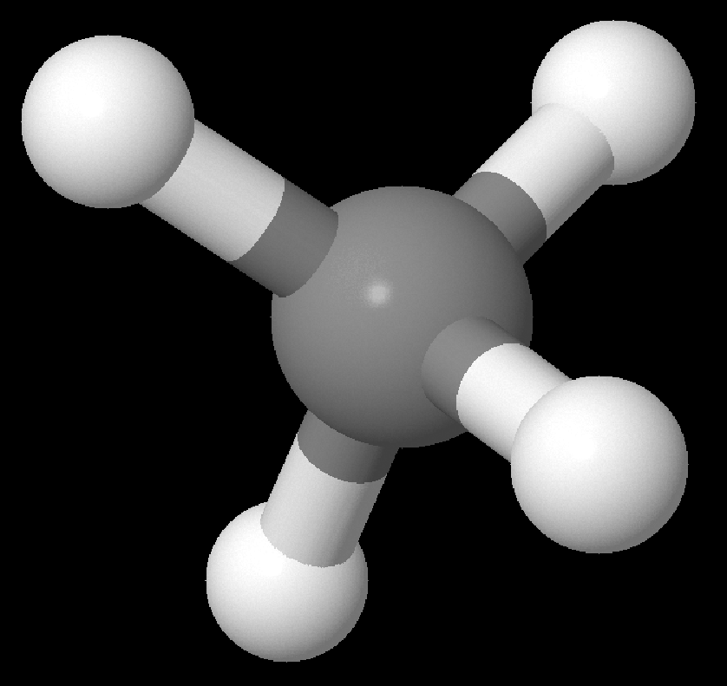
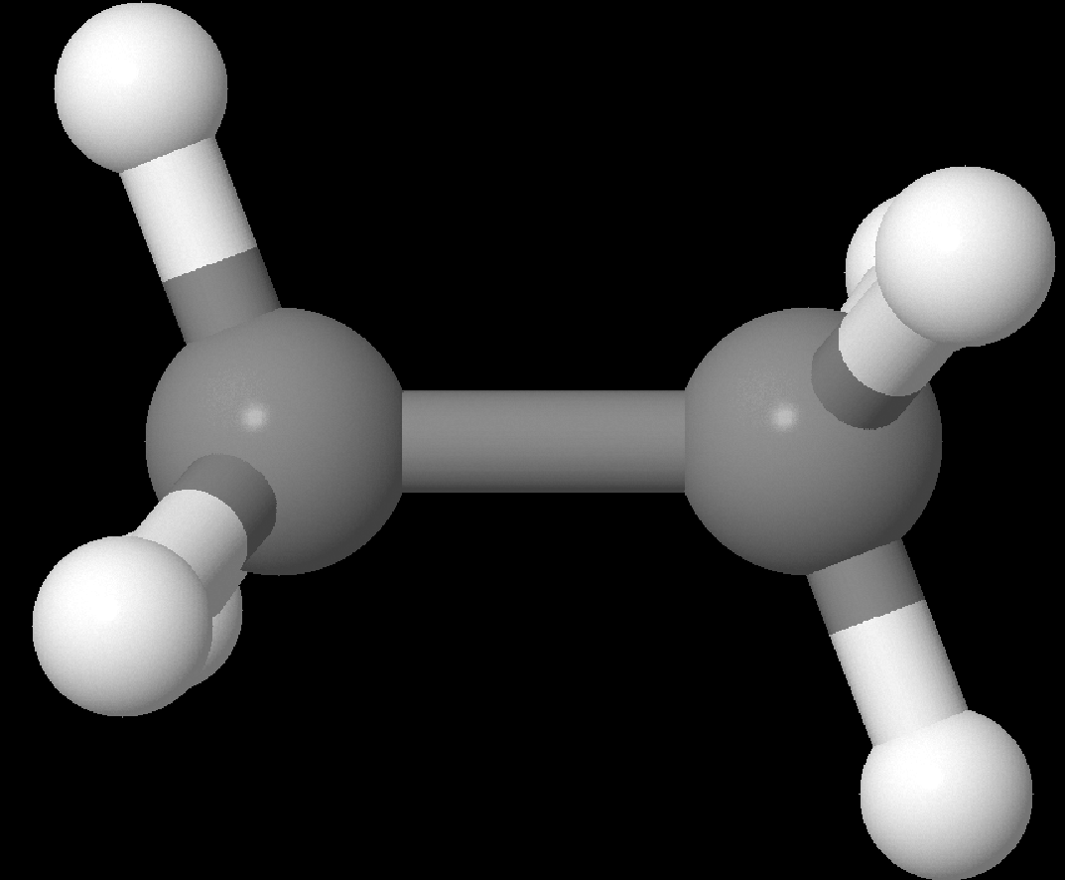
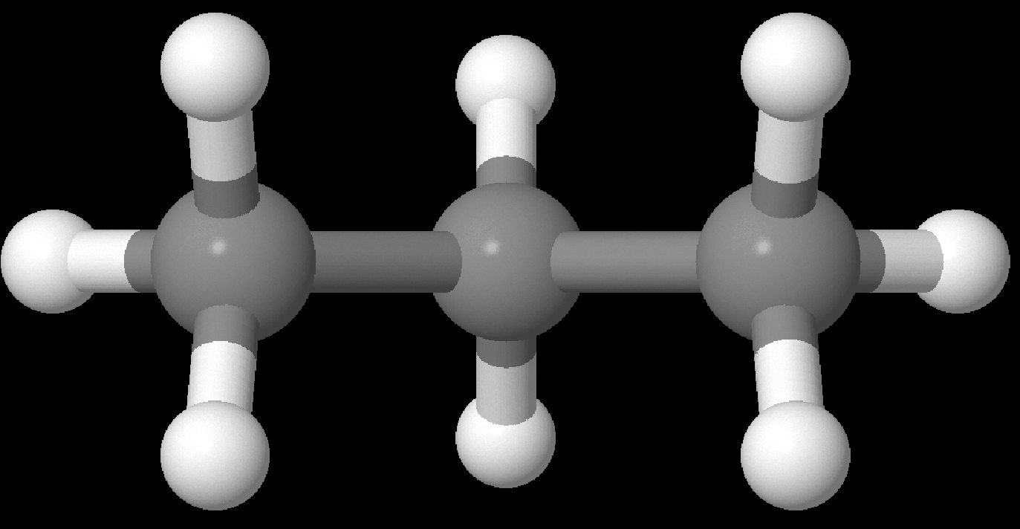
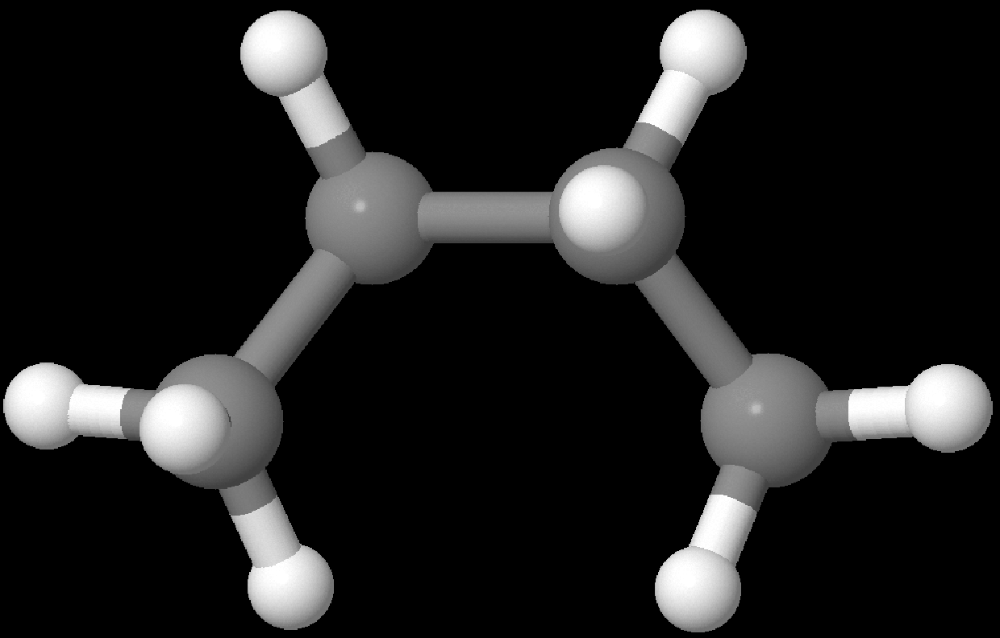
1.2 Hydrocarbons
7
Methane (CH₄)
Hydrocarbons are common precursors in CE studies [46, 64-69] due to their ubiquity in natural [70] and astrophysical environments [71,72].
Have yet to elucidate:
Laser intensity thresholds for ionization, fragmentation, and dissociation
Dynamic understanding of the fragmentation process
Product frequency distributions that are yielded from the explosion
Ethane (C₂H₆)
Propane (C₃H₈)
Butane (C₄H₁₀)

Slide 8
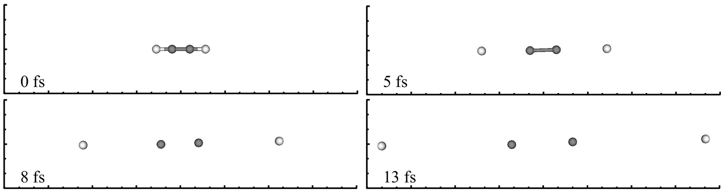
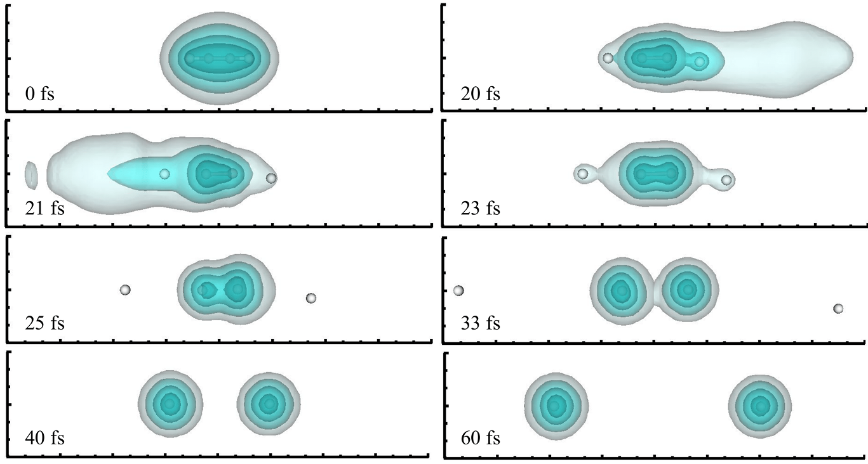
1.3 Theoretical Models
8
Classical C₂H₂ Coulomb Explosion Simulation
Classical methods [25–29, 56, 73–83]
Purely repulsive interactions between positively charged cores
Neglect attractive forces from electron densities
Omit quantum effects
Does not allow for fragments to form
Does not capture the nuanced dynamics
Semi-classical methods [9, 84]
Does not capture nuanced electron dynamics
Ab initio methods [85-91]. Time-dependent density-functional theory (TDDFT) [92, 93]
Captures the nuanced electron dynamics, quantum effects, allows fragment formation
Demonstrated accuracy in reproducing experimental results [87–91]
TDDFT C₂H₂ Coulomb Explosion Simulation

Slide 9
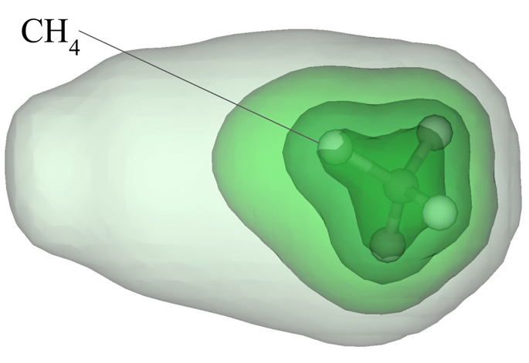
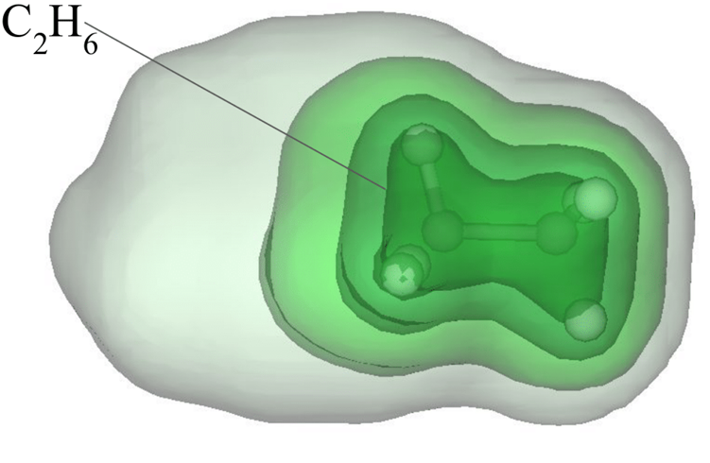
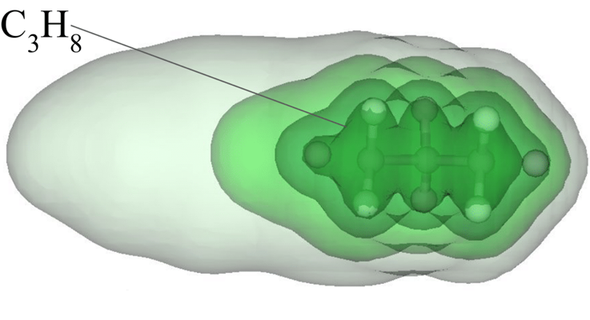
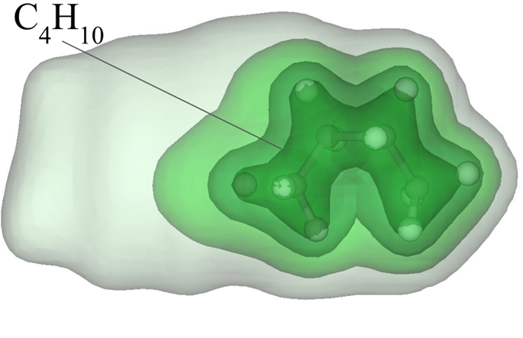
1.4 Research Objectives and Approach
9
TDDFT simulations are employed to explore the fragmentation dynamics of hydrocarbons under Coulomb explosion induced by intense laser fields.
Motivation:
Recent experiments observed CH radicals and other fragments resulting from the Coulomb explosion of ethene [94] and butane [95].
Surprising results:
Earlier experiments [32, 91] show that strong laser pulses dissociate H atoms from hydrocarbons
This study:
Methane, ethane, propane, and butane
Laser intensity thresholds for ionization, fragmentation, and dissociation
Fragmentation dynamics
Fragmentation distributions

Slide 10
Computational Method
10

Slide 11
11
2. Computational Method
2.1 Overview
Real-space grid used. Represent density of valence electrons
Core electrons represented with norm-conserving Troullier-Martins pseudopotentials
Density Functional Theory (DFT) calculation performed to calculate the ground state
Use the Kohn-sham Hamiltonian
The time–dependent orbitals are propagated using a fourth-order Taylor expansion of the time-evolution operator
Motions of the ions in the simulation are treated classically with electron-ion force modeled via Ehrenfest theorem
A complex absorbing potential (CAP) is implemented to prevent reflections of the wave function at the boundary

Slide 12
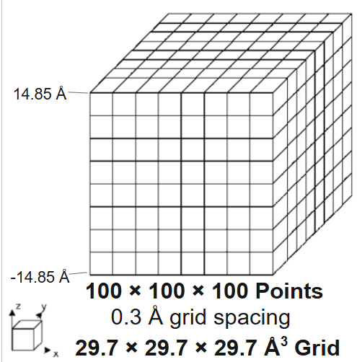
12
2. Computational Method
2.2 Real Space Grid

Slide 13
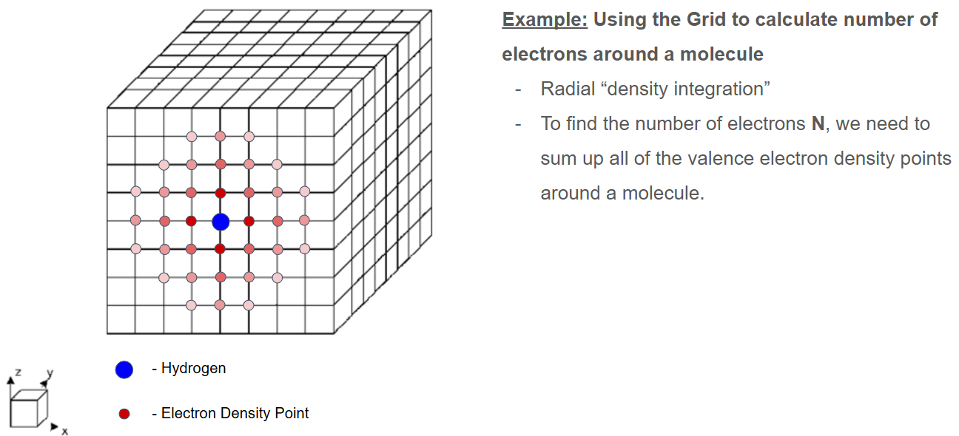
13
2. Computational Method
2.2 Real Space Grid

Slide 14
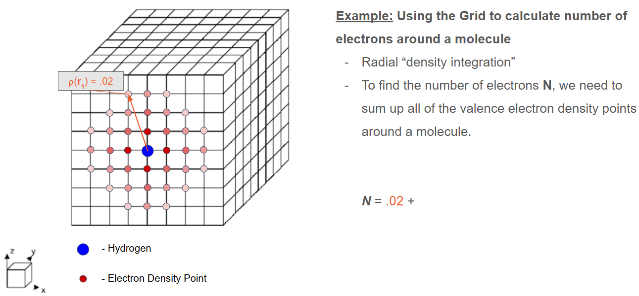
14
2. Computational Method
2.2 Real Space Grid

Slide 15
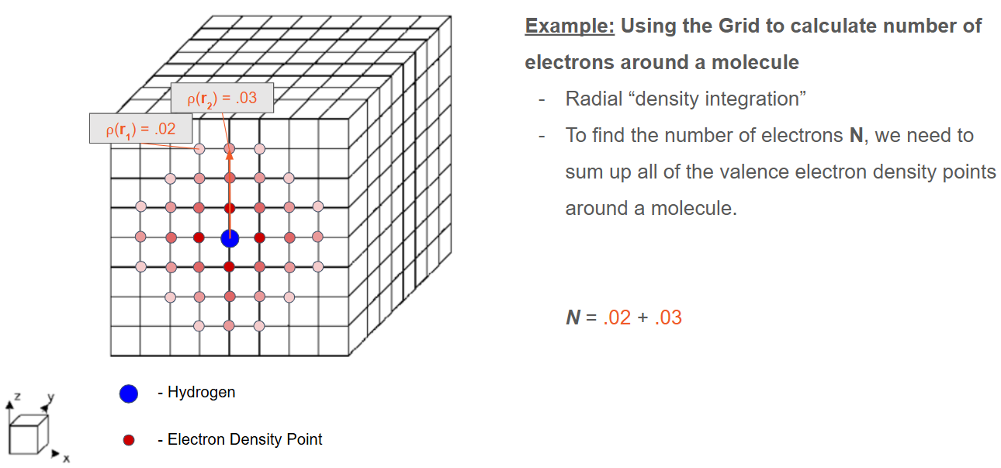
15
2. Computational Method
2.2 Real Space Grid

Slide 16
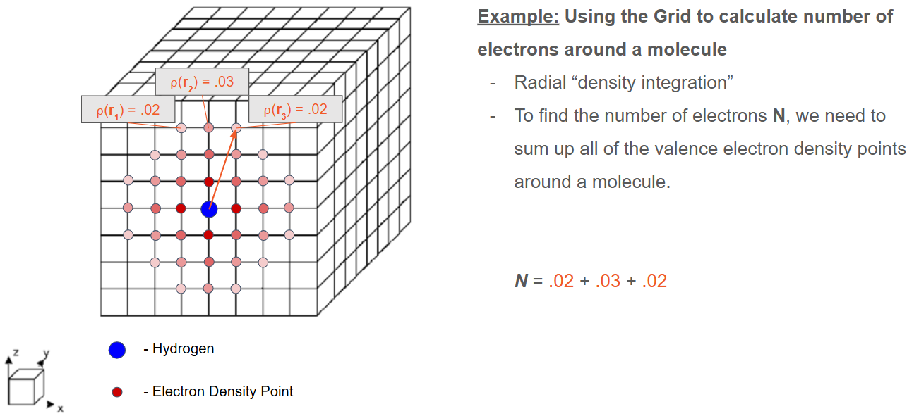
16
2. Computational Method
2.2 Real Space Grid

Slide 17
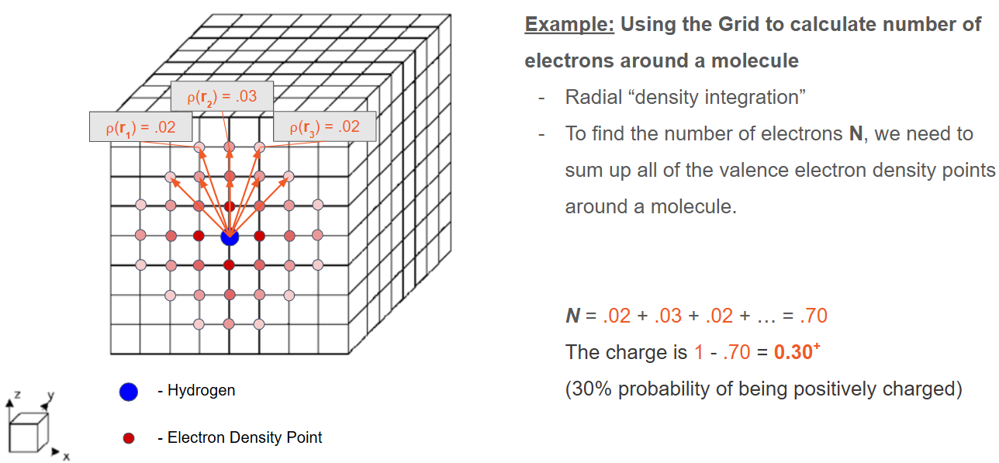
17
2. Computational Method
2.2 Real Space Grid

Slide 18
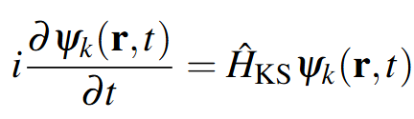
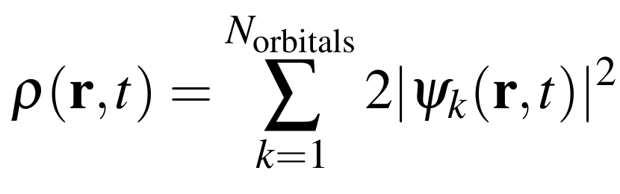
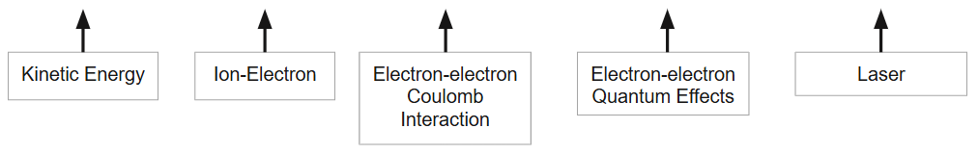
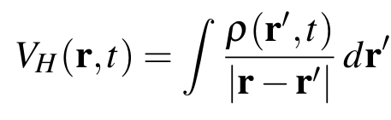
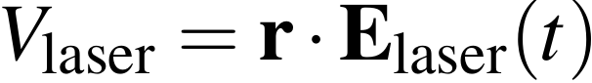
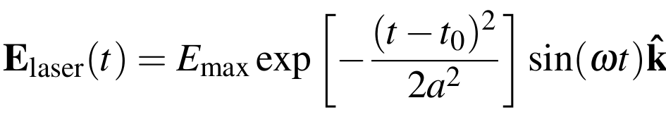
18
2. Computational Method
2.3 Hamiltonian
Time-dependent KS equation:
9 point finite differencing
Troullier-Martins Psuedopotentials [97]
Adiabatic Local-
Density Approximation
(ALDA) by Perdew and Zunger [98].
Dipole Approximation
To get initial density ρ and the molecule’s ground state, a DFT calculation is performed

Slide 19
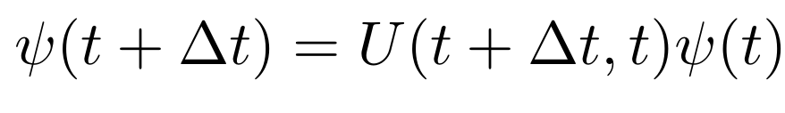
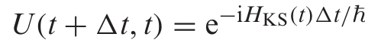
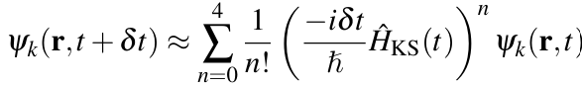
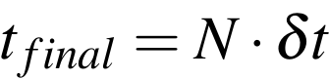
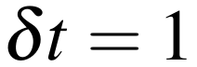

19
2. Computational Method
2.4 Time Propagator
Time-dependent KS equation:
Fourth order Taylor Expansion
The operator is applied for N time steps until the final time
N=120000 time steps
t_{final}=120 fs

Slide 20
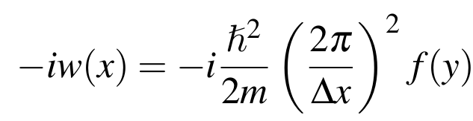
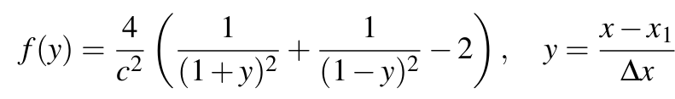
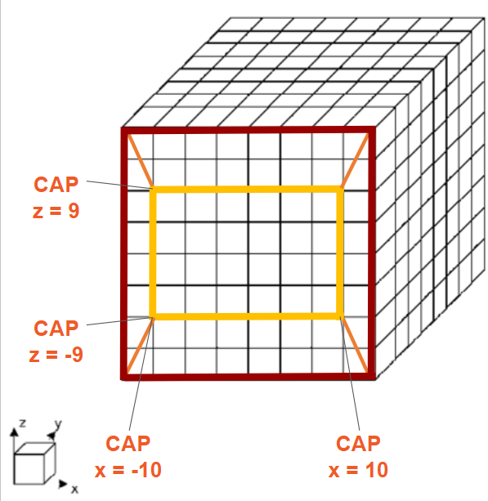
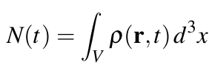
20
2. Computational Method
2.5 Complex Absorbing Potential (CAP)
Described by Manopolous[97]
Any electron density that touch the CAP are absorbed.
The total electron number:
CAP set at:
-10 and 10 Å on the x-axis
-9 and 9 Å on the y- and z-axis
Will diverge from the initial electron number, N(0).
N(t)-N(0) → total number of electrons ejected from the simulation box

Slide 21
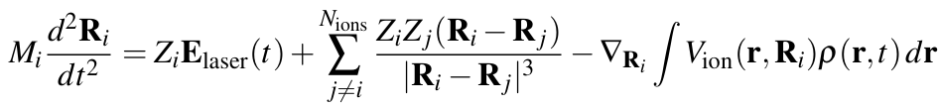
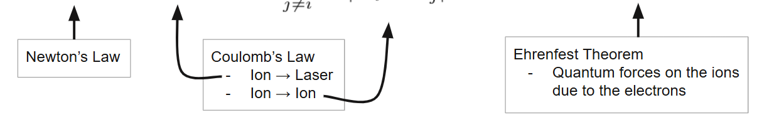
21
2. Computational Method
2.6 Ionic Motion
Movement of the ions treated classically. Newton’s second law: F=ma
M_{i} is the mass and Z_{i} is the charge of the i^{th} ion. N_{ions} is the total number of ions.
Propagated using the Verlet algorithm at every time step δt.

Slide 22
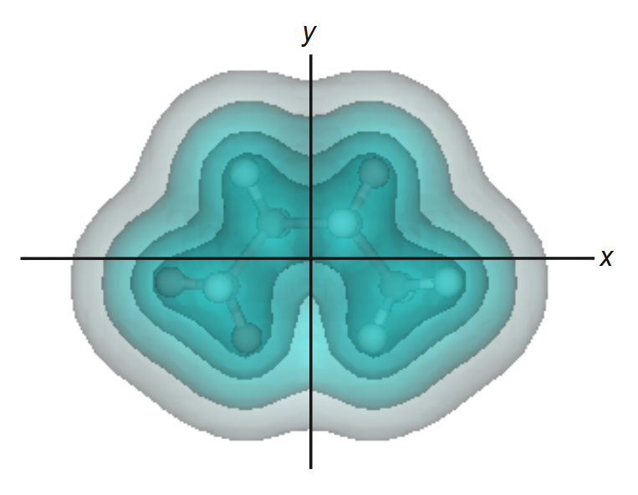
22
2. Computational Method
2.7 - Parameters
Each molecule placed in center of simulation box (with its longest molecular axis on the x-axis and shortest on the z-axis)
Maximized ionization [87]
Molecular alignment achievable in experiment [5]
Each simulation: ion velocities initialized according to Boltzmann distribution at 300 K
Facilitates different fragmentation pathways
Over 50 simulations for each molecule to get large distribution of C_{n}H_{m} fragments in several instances across all tested molecules.

Slide 23
23
2. Computational Method
In the following section…
Laser intensity thresholds for ionization, fragmentation, and dissociation of the first four alkanes
Methane (CH₄), Ethane (C₂H₆), Propane (C₃H₈), Butane (C₄H₁₀)
Fragmentation dynamics and how fragments form
Fragmentation distributions using the optimal fragmentation laser parameters

Slide 24
Results
24

Slide 25
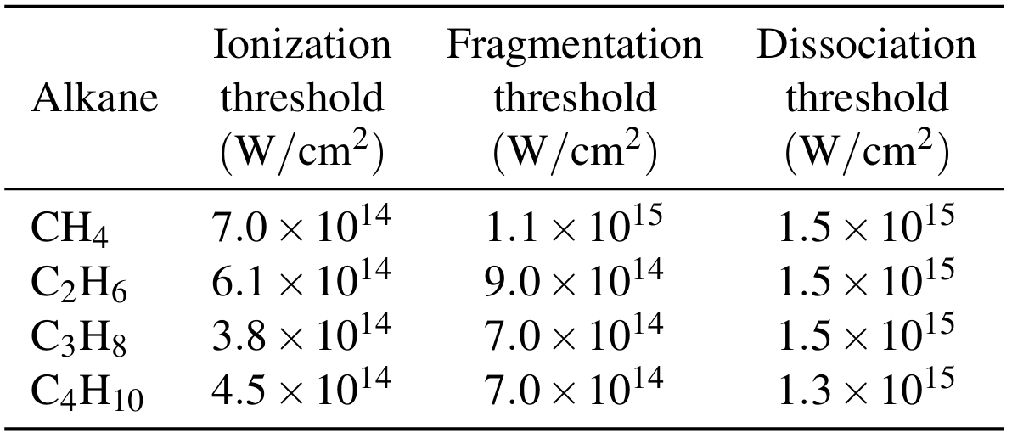
25
3.1 Laser Parameters and Intensity Optimization
All simulations employed a pulse wavelength of 890 nm, duration of 7.8 fs (FWHM), and x-axis polarized
Intensity is the only variable parameter.
(1) Intensities below the ionization threshold, which result in minimal dissociation
(2) Intensities near the fragmentation threshold, which produce partial breakup and smaller ionized fragments
(3) Intensities exceeding the dissociation threshold, result in complete molecular breakup driven by strong Coulomb repulsion between the ions
In experiment, only a fraction of the molecular target is exposed to the laser pulse’s peak intensity.
Molecules outside the focal region interact with lower-intensity fields, resulting in a range of fragmentation pathways occurring simultaneously

Slide 26
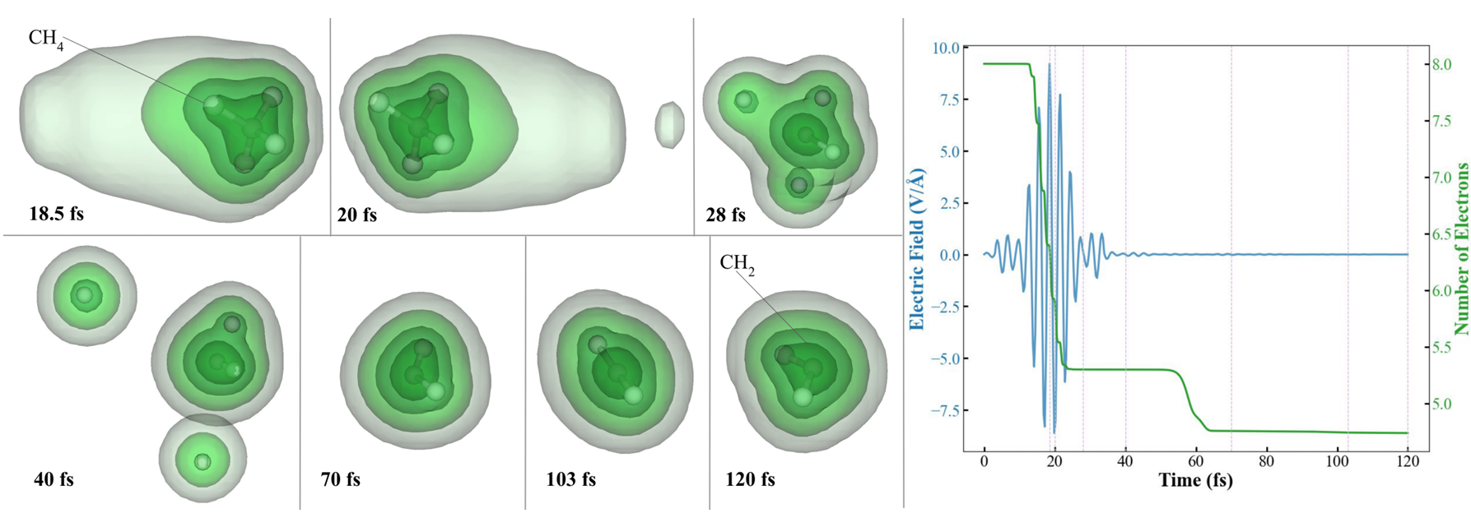
26
3.2 Methane (CH₄)
3.2.1 Dynamics
Ionization begins when E-Field reaches about 5.5 V/Å (~14 fs). Concludes when E-field falls below 6 V/Å (~24 fs)
The CH₂ and the two ejected hydrogen have charges of 1.26+, 0.62+, and 0.84+, respectively
Leaves 5.3 valence electrons in the system after ionization.
Non-integer electron count result from electron density integration
Structural rearrangement: 70 fs: right-bent 103 fs: linear 120 fs: left-bent

Slide 27
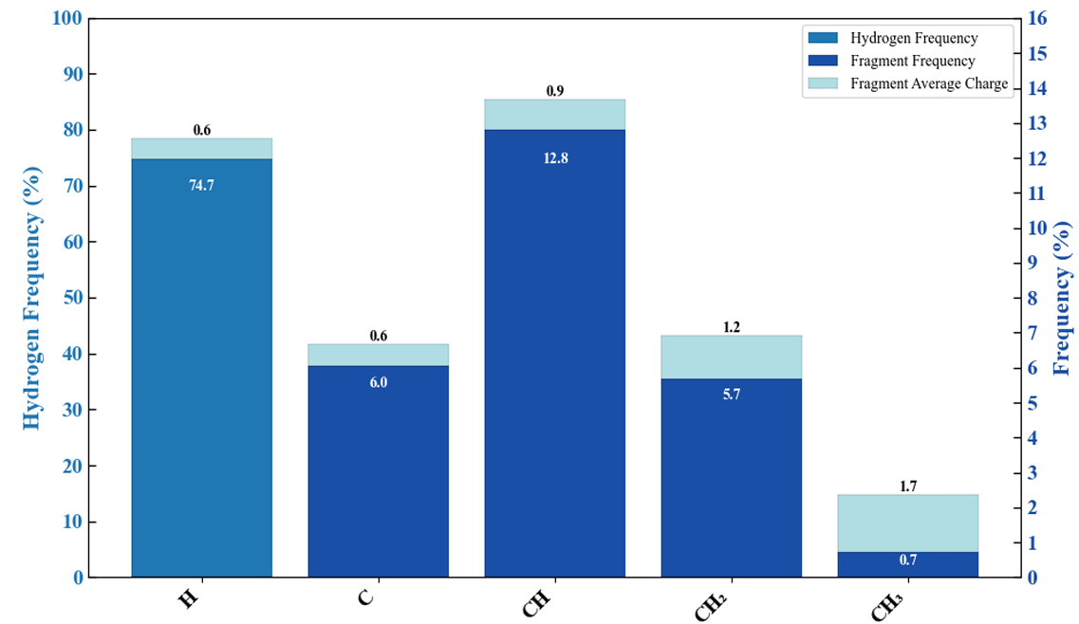
27
3.2 Methane (CH₄)
3.2.2 Distribution From 71 CH₄ CE simulations with pulse intensity of $1.1 ×{10}^{15}$ W/cm²
Large variety of fragments
No CH₄ fragments detected → laser pulse intensity strong enough to eject at least 1 hydrogen
CH is most frequently observed carbon containing species
H atoms are mot frequent overall
On average, the laser ejected 2.72 electrons per simulation

Slide 28
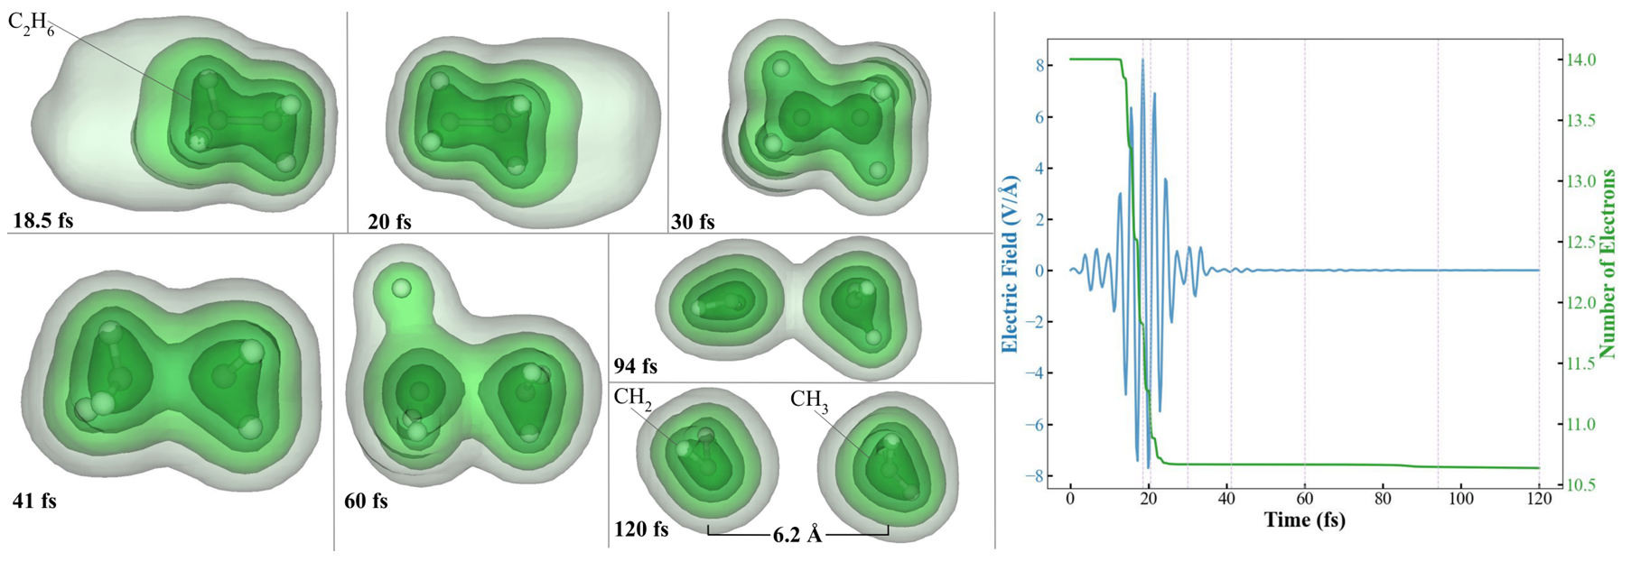
28
3.3 Ethane (C₂H₆)
3.3.1 Dynamics
Ionization begins when E-Field reaches about 5 V/Å (~14 fs). Concludes when E-field falls below 6 V/Å (~22 fs)
At 60 fs: The fragment on the left ejects a hydrogen due to asymmetric charge distribution
The CH₂ and CH₃ fragments both have charges of 1.18+
Leaves 10.7 valence electrons in the system after ionization.
Rotational motion in CH₂ fragment: 60-94 fs: 90° clockwise rotation about z-axis 94-120 fs: addition 90° rotation

Slide 29
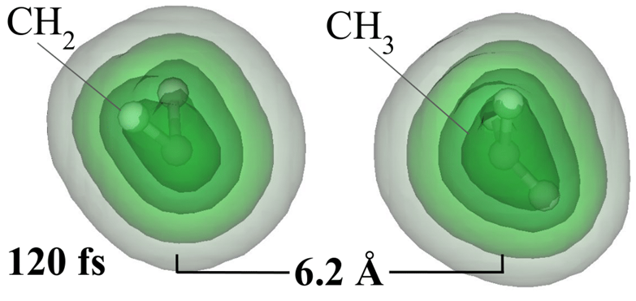
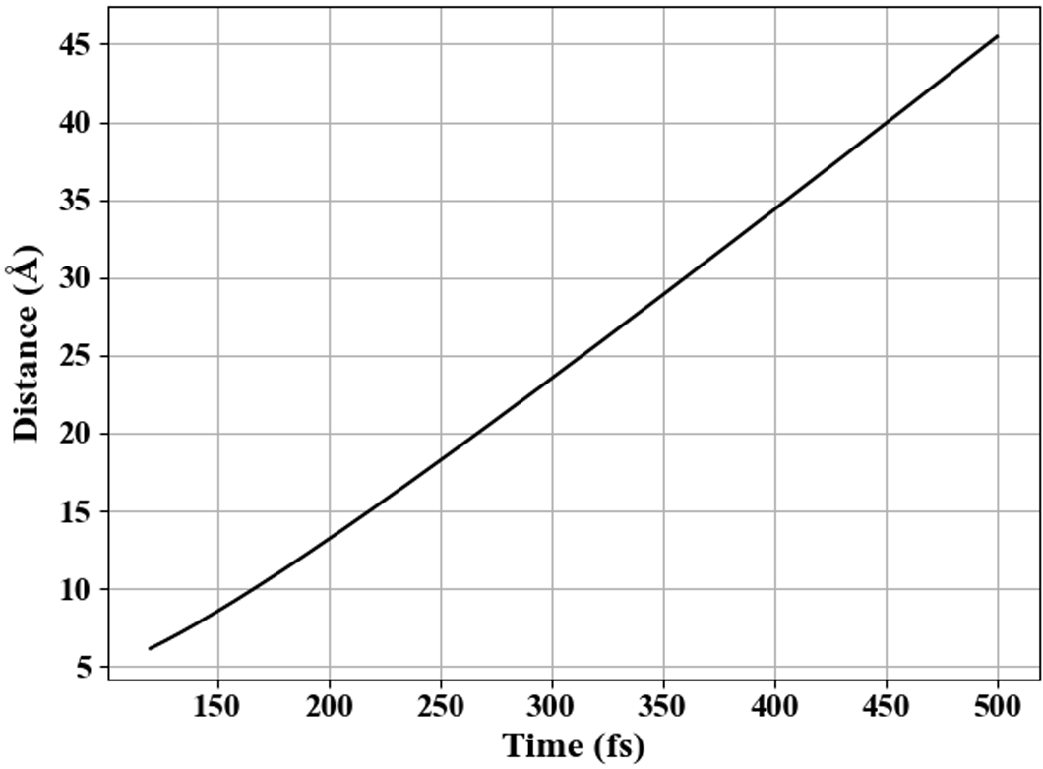
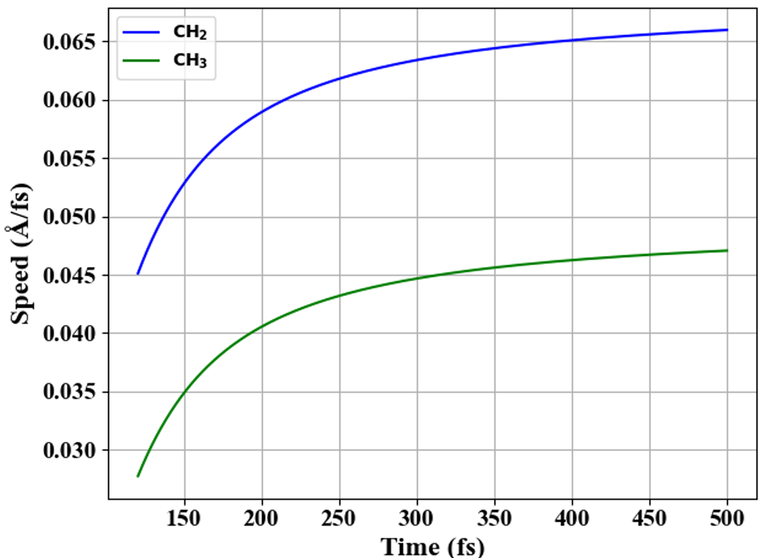
29
3.3 Ethane (C₂H₆)
3.3.1 Dynamics
By the end of the 120 fs, the CH₂ and CH₃ fragments are separated by 6.2 Å
Assuming classical repulsion after this point:
By 500 fs, the fragments separate by 45 Å
By 500 fs, the CH₂ and CH₃ have speeds of 6600 m/s and 4700 m/s
Experiment: the velocity of the CH2+ ion in Coulomb explosion of methanol measured to be 4800 m/s [57]
Same magnitude as in the present calculations

Slide 30
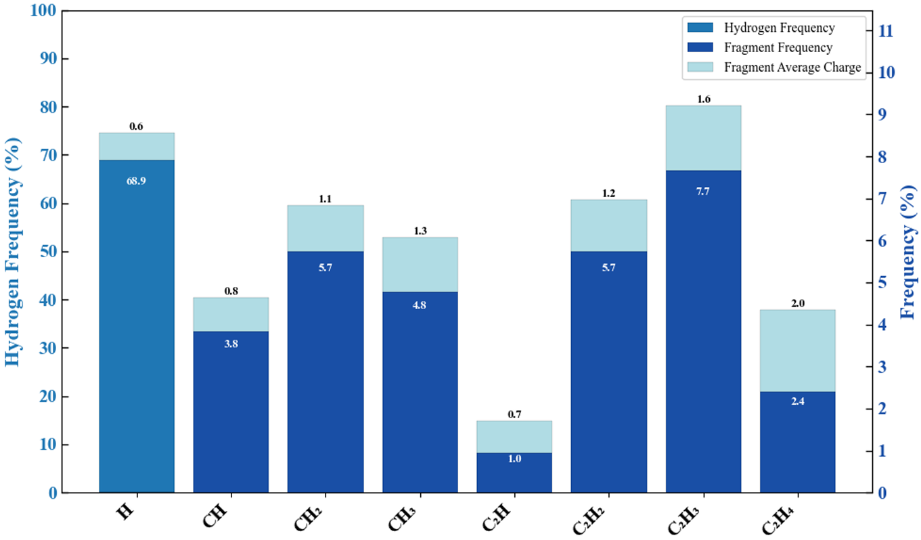
30
3.3 Ethane (C₂H₆)
3.3.2 Distribution From 50 C₂H₆ CE simulations with pulse intensity of $9.0 ×{10}^{14}$ W/cm²
Large variety of fragments
Laser pulse intensity strong enough to eject at least 2 hydrogen
C₂H₃ is most frequently observed carbon containing species
H atoms are most frequent overall
On average, the laser ejected 3.42 electrons per simulation

Slide 31
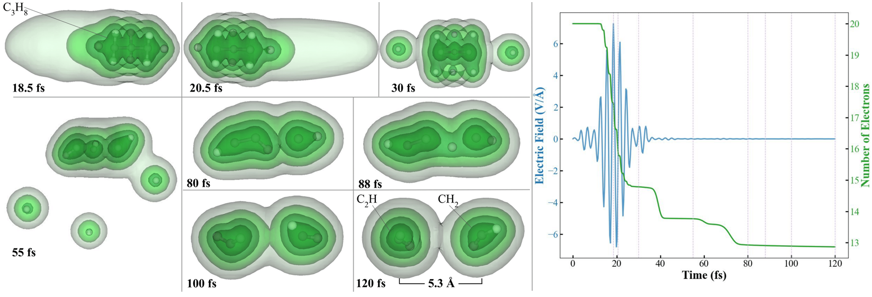
31
3.4 Propane (C₃H₈)
3.4.1 Dynamics
Ionization begins when E-Field exceeds about 4 V/Å (~14 to 24 fs).
The C₂H and CH₂ fragments have charges of 2.22+ and 0.91+, respectively
Leaves 14.8 valence electrons in the system after ionization.
Atom Transfer: At 88 fs, C₂H₂ transfers an H atom to CH → Leaving C₂H and CH₂ fragments by 120 fs

Slide 32
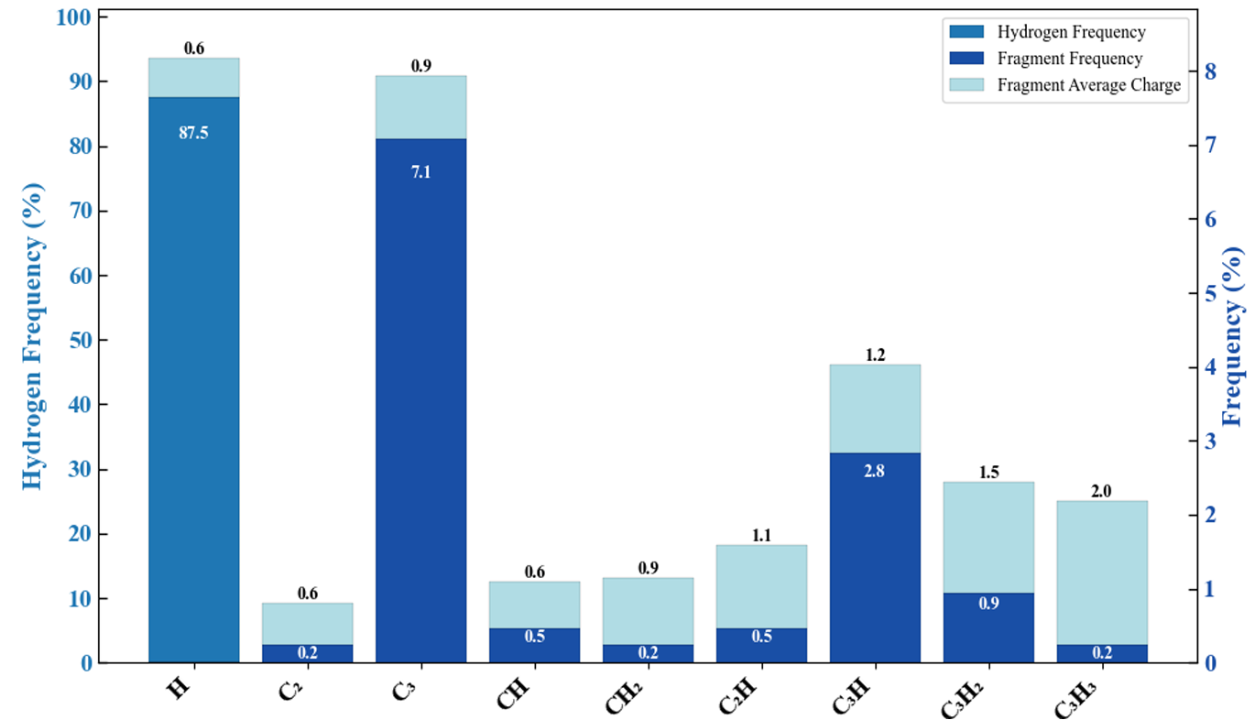
32
3.4 Propane (C₃H₈)
3.4.2 Distribution From 50 C₃H₈ CE simulations with pulse intensity of $7.0 ×{10}^{14}$ W/cm²
Laser pulse intensity strong enough to eject at least 5 hydrogen
C₃H is most produced hydrocarbon
C₃ is most frequently observed carbon containing species
H atoms are most frequence overall
On average, the laser ejected 5.15 electrons per simulation

Slide 33
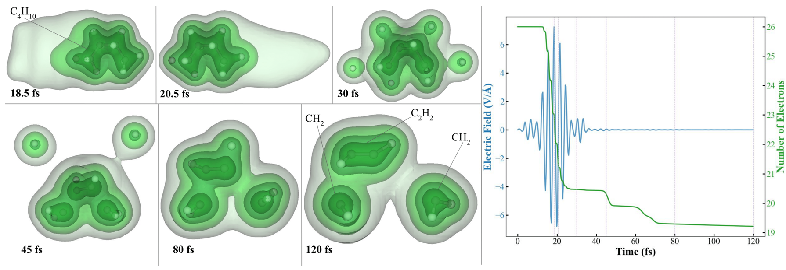
33
3.5 Butane (C₄H₁₀)
3.5.1 Dynamics
Ionization begins when E-Field exceeds about 4 V/Å (~14 to 24 fs).
Two hydrogens ejected post ionization at 30 fs. Two more at around 45 fs.
The C₂H₂ and two CH₂ fragments have charges of 1.12+, 0.77+, and 0.90+, respectively
Leaves 20.5 valence electrons in the system after ionization.

Slide 34
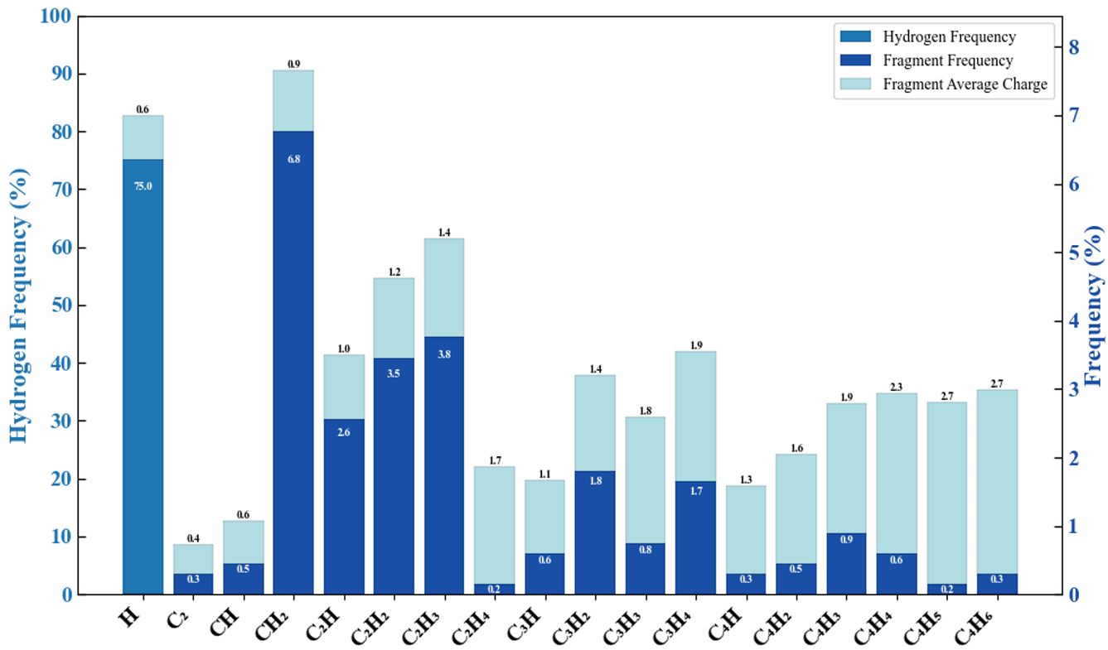
34
3.5 Butane (C₄H₁₀)
3.5.2 Distribution From 88 C₄H₁₀ CE simulations with pulse intensity of $7.0 ×{10}^{14}$ W/cm²
Laser pulse intensity strong enough to eject at least 4 hydrogen
CH₂ is most frequent hydrocarbon
H atoms are most frequence overall
On average, the laser ejected 5.54 electrons per simulation

Slide 35
Summary
35

Slide 36


4. Summary
36
Fragmentation in the Coulomb explosion of hydrocarbon molecules was investigated using TDDFT
Laser intensity thresholds for ionization, fragmentation, and dissociation identified (Table 3.1)
The snapshots enable the study of fragment dynamics after the laser-driven ionization:
Structural rearrangements (Fig. 3.1)
Rotations (Fig. 3.3),
Transfer of atoms between different fragments (Fig. 3.6).
Distributions show possible fragmentation outcomes and average charge states. Similarities between histograms:
Average charge of the hydrogen is consistently 0.6+ across all precursor molecules.
The two smaller alkanes (CH₄ and C₂H₆) produced CH fragments with an average charge of 0.8+, while the two larger alkanes (C₃H₈ and C₄H₁₀) yielded CH fragments with an average charge of 0.6+.

Slide 37


References
37

Slide 38



References
38

Slide 39


References
39

Slide 40



References
40

Slide 41


References
41

Slide 42
Thank you!

